Slide 1


E D E S T A L
A Programming Language Inspired by Scratch.mit.edu

Slide 2



PEDESTAL TEAM
Danish Baloch
Sarfaraz Ahmed
Shehmeer Ashfaq
Team Lead
Team Member
Team Member

Slide 3


WHY WE MADE PEDESTAL ?
Before this it is good to know about Esoteric Languages.
What are basically Esoteric Languages ?

Slide 4

ESOTERIC LANGUAGES
An esoteric programming language is a programming language designed to test the boundaries of computer programming language design, as a proof of concept, as software art, as a hacking interface to another language, or as a joke.

Slide 5

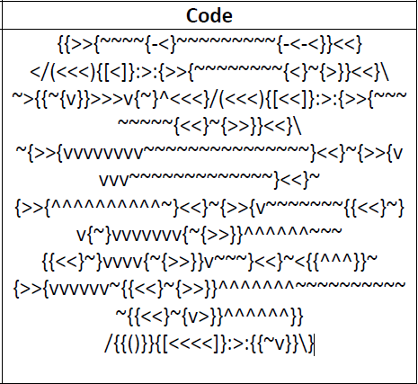
SOME FAMOUS ESOTERIC LANGUAGES
Acronym
Arnold C
Shakespeare Programming Language
Whitespace
LOLCODE

Slide 6




PEDESTAL FEATURES
Pedestal is designed as Natural Language, in English. But keeping programming concepts in mind the structured is designed so that the user can understand the programming fundamentals.
Easy to read
Pedestal syntax is easy to read and comprehend. Basically we are more.
Starter for School kids
Coding in High Level Languages will be easy to understand when user interactive syntax of pedestal.
As, Esoteric Languages are hard to understand and code. Pedestal is a counter to it. It Is easy to code and understand. And it is not implemented as a joke basically.
Programming Fundamentals
The syntax will help new learners, kids and school students to understand the basic programming fundamentals.
Counter to Esoteric Languages

Slide 7
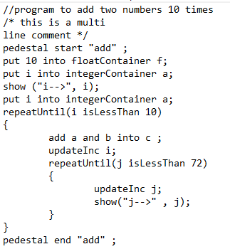
PEDESTAL PROGRAM
A pedestal program is divided into three sections.
Header of Program
Body of Program
Footer of Program

Slide 8
PEDESTAL CFG
How a Pedestal File is Written ?
1
2
3
Header
Body Section
Footer
Header is required for the main( ) section of the file to be complete.
Body section can be empty with no statement or it can have only one statement or can have multiple statements. Statement include loops, nested loops, variable declaration, print command , operations, function declaration, function call and functions definitions.
Footer is also required in pedestal File. It mentions the end of the file and completes the main section of file.

Slide 9




How Pedestal works up to Syntax Analyzer Phase.
There are Three main aspects of pedestal.
1 - First
Input of source file
First the Input file
of a Pedestal programs is given to
The lexical analyzer.
2 - Second
Tokenizing of Source File
This Lexical Analyzer generates
Valid Tokens and store them in a data
Structure.
3 - Third
Mapping of Tokens on grammar
The Tokens generated are mapped on
Grammar of our language. And correct
Syntax is Parsed.
Valid Tokens
Syntax Analyzing

Slide 10
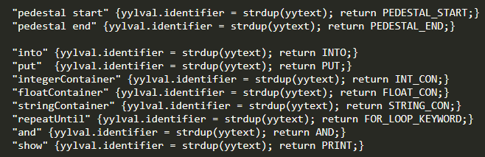
FLEX REGULAR EXPRESSIONS
KEYWORDS
These are the Flex Regular Expressions that generates Tokens.

Slide 11

FLEX REGULAR EXPRESSIONS
OPERATORS

Slide 12
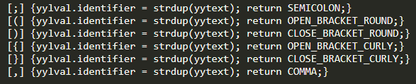
FLEX REGULAR EXPRESSIONS
SEPERATORS

Slide 13

FLEX REGULAR EXPRESSIONS
INTEGER , FLOAT, STRING LITERALS AND IDENTIFIER

Slide 14

FLEX REGULAR EXPRESSIONS
IGNORING WHITESPACES, TABS, NEW LINES,
SINGLE LINE COMMENTS AND MULTI-LINE COMMENTS

Slide 15
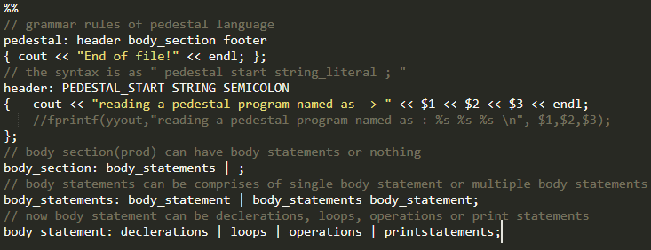
CFG OF PEDESTAL IMPLEMENTED IN BISON
| functions

Slide 16
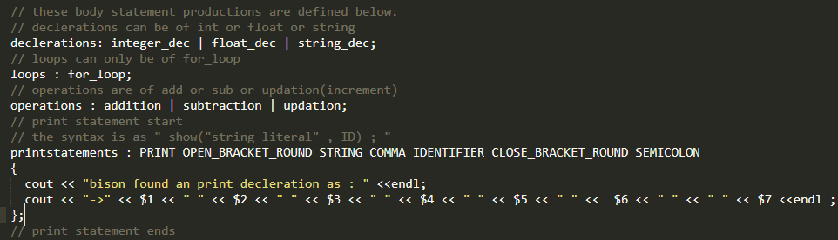
CFG OF PEDESTAL IMPLEMENTED IN BISON

Slide 17
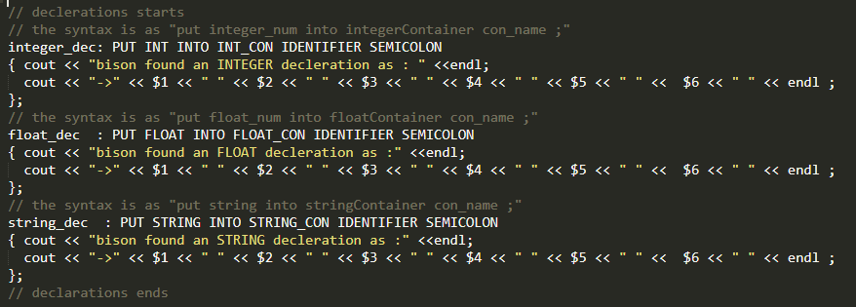
CFG OF PEDESTAL IMPLEMENTED IN BISON

Slide 18
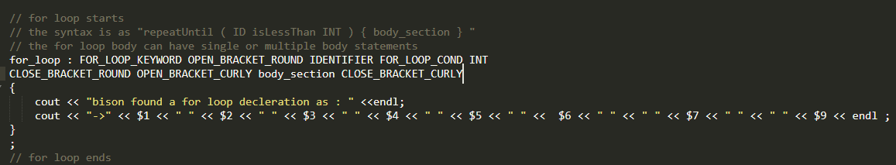
CFG OF PEDESTAL IMPLEMENTED IN BISON

Slide 19
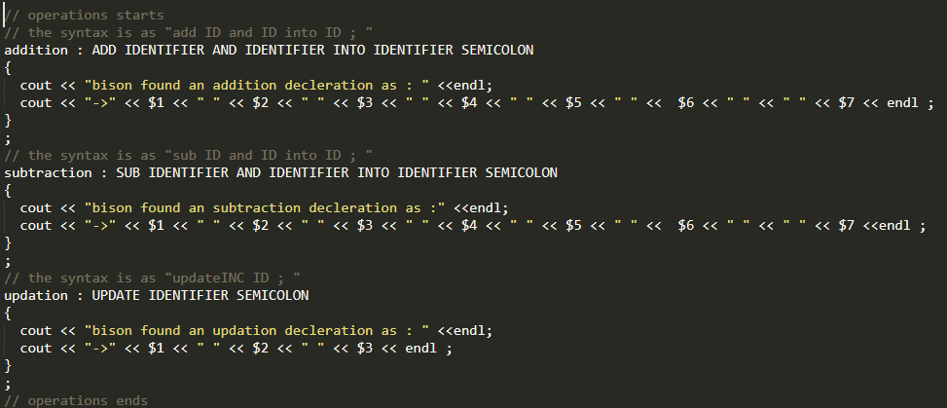
CFG OF PEDESTAL IMPLEMENTED IN BISON

Slide 20
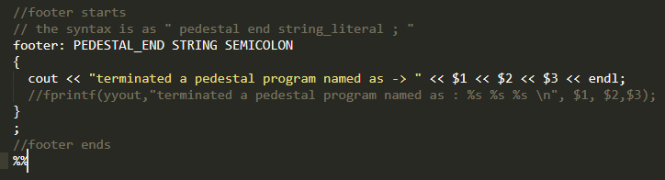
CFG OF PEDESTAL IMPLEMENTED IN BISON

Slide 21
TEAM WORK
After completion of Pedestal Language. We have updated our PLS and created this presentation.
I have made Lexical Analyzer and Parser of pedestal in C++.
I have done Bison Grammar Productions and Conversions of NFA’s to DFA’S.
I have done Flex Regular Expressions and Conversions of NFA’s to DFA’s.
Danish Baloch
Sarfaraz Ahmed
Shehmeer Ashfaq
Team Lead
Team Member
Team Member

Slide 22

THANK YOU!
23

